Slide 1

RealEase: Comprehensive Real Estate Insights Platform
Milestone 5 Overview
By Donovan Murphy, Jonathan Bailey, and Enrique Obregon

Slide 2
Milestone Overview
Website V2 Revamp
Local DB Caching for Search and Insight
Home comparison updates
Market Insights

Slide 3
Milestone Four Plan
Task | Donovan | Jonathan | Enrique
1. Finalize caching implementation & optimize user location tracking | implement/test 40% | Research 20% | Research/implement 40%
2. Continue to develop and begin testing of Neighborhood Insights Tool | Design 50% | Design 25% | Design 25%
3. Finalize ROI tool & improve frontend styling | Implement 40% | Implement 30% | Implement 30%

Slide 4
Task 1: Neighborhood Market Insights
Provide the user with valuable market trends and averages
Continued progress on front end integration

Slide 5
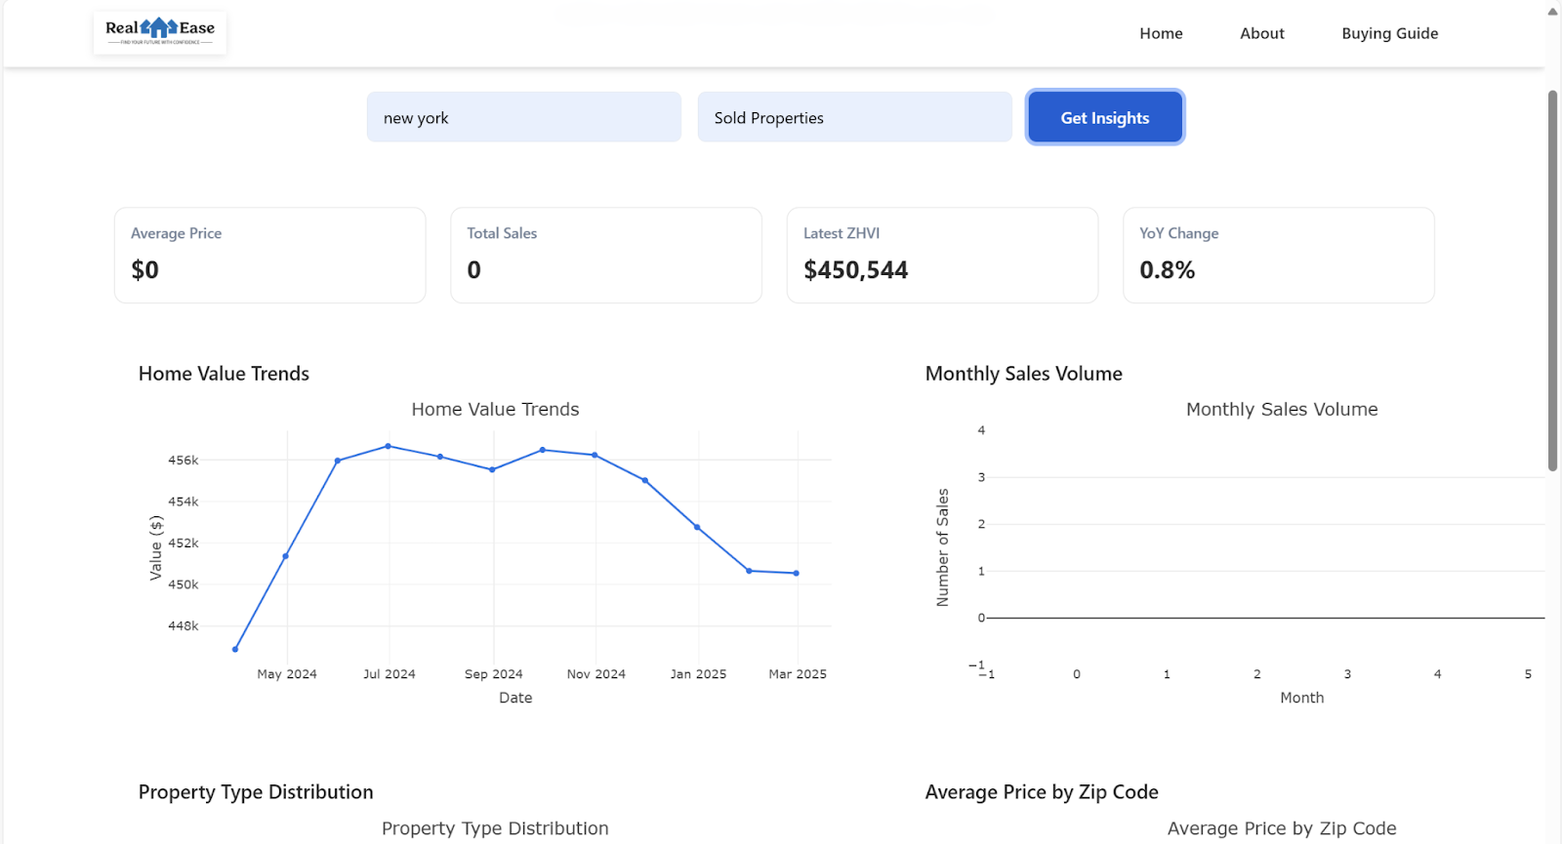
Task 1: Demo Image

Slide 6
Task 2: Website Refresh
New frontend architecture, resulting in a more responsive and visually appealing interface as well as speeding up the time it takes for a user to search for a house (caching method added)
The redesigned property cards and detail pages significantly improve the user experience with intuitive navigation and clearer information hierarchy.

Slide 7
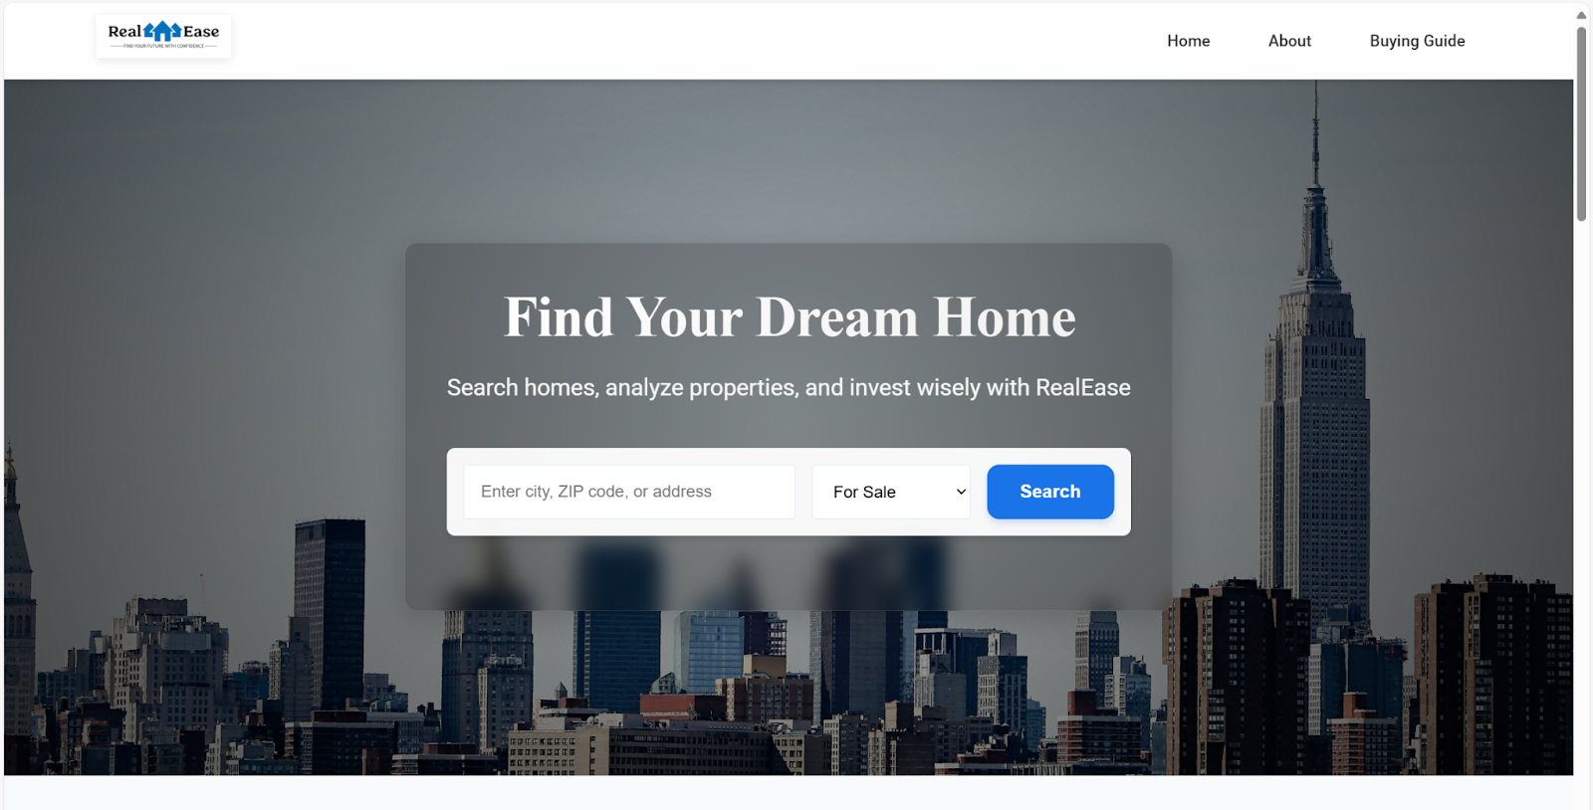
Task 2: Front End Demo Image

Slide 8
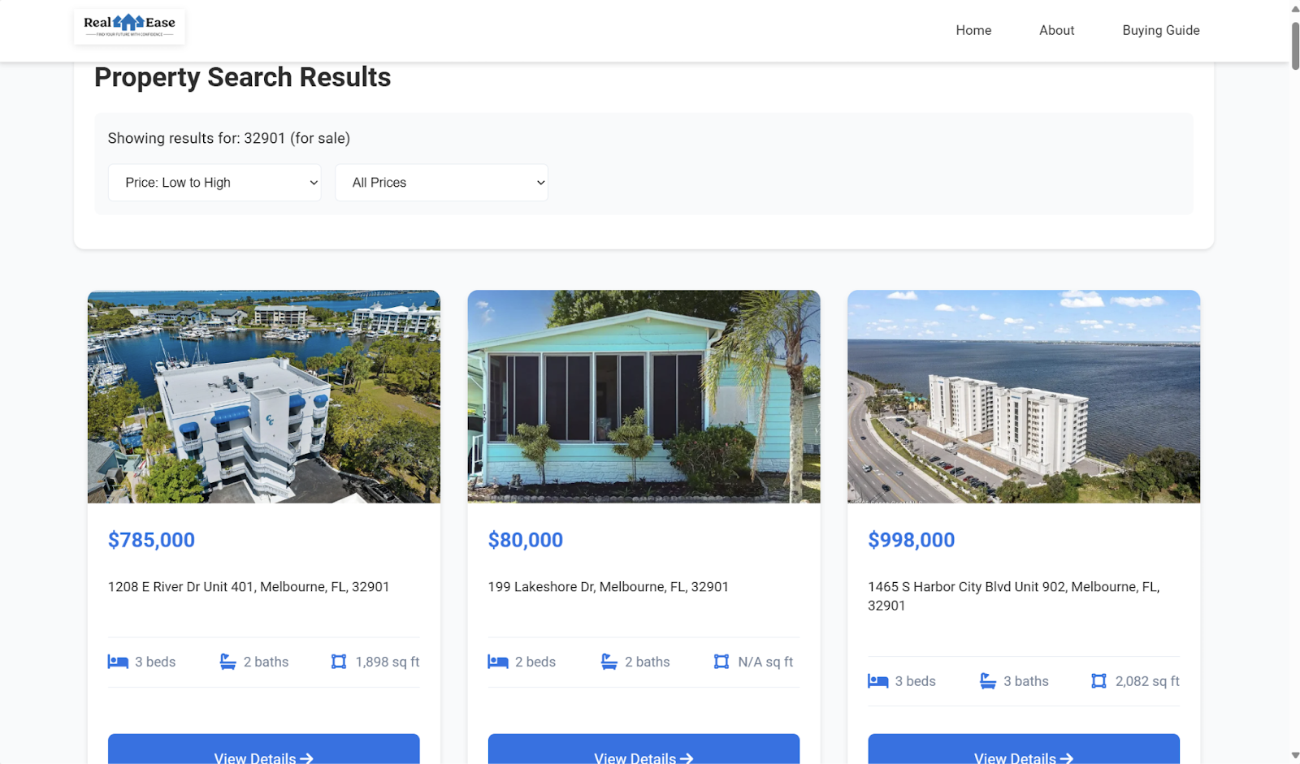

Task 3: Working Website Demos
We developed a comprehensive demonstration workflow that showcases our platform's key functionality. Users can now experience the complete journey from property search to detailed analysis, including the comparison tool and ROI calculator.

Slide 9
Milestone Five Plan
Task | Donovan | Jonathan | Enrique
1. Finish Neighborhood Insights Dashboard | implement/test 40% | Research 20% | Research/implement 40%
2. Test all tools thoroughly | Design 50% | Design 25% | Design 25%
3. Touch up anything as suggested by advisor and or instructor | Implement 40% | Implement 30% | Implement 30%
4. Integrate with python everywhere | Implement 40% | Implement 30% | Implement 30%

Slide 10
Task 1: Fully Flesh Out Neighborhood Insights
Integrate all data sources to work with user input
Improve speed and efficiency

Slide 11
Task 2: Test All Tools
Incorporate the API data we are getting for crime rates, school ratings, and local business information for each user location query (zip code) to the front end
Thoughtful UI presentation to ensure a seamless user experience and resolve any bugs or usability issues

Slide 12
Task 3: Touch Up Based on Feedback
Continue to improve latency
Revisit how we Clean Data before going into the frontend cards.

Slide 13
Faculty Advisor Feedback
Guidance on Data Retrieval Planning
Emphasis on unified data pull strategies to maintain performance.
Demo Development:
Iterative improvement based on client feedback to enhance user experience.
Caching and Lazy Loading
Focus on reducing latency to retain user engagement.

Slide 14

Questions?

